Slide 1

6th Grade Accelerated Math
Unit 11, Lesson 6 Solving Real-World Problems with Rational Numbers – Part 2 Volume 2, pg. 190

Slide 2


Benchmark
MA.7.NSO.2.3
Solve real-world problems involving any of the four operations with rational numbers.
volume 2, pg. 190

Slide 3
Integrated Mathematical Thinking and Reasoning Standards
MA.K12.MTR.1.1 Actively participate in effortful learning both individually and collectively.
MA.K12.MTR.3.1 Complete tasks with mathematical fluency.
MA.K12.MTR.4.1 Engage in discussions that reflect on the mathematical thinking of self and others.
MA.K12.MTR.5.1 Use patterns and structure to help understand and connect mathematical concepts.
MA.K12.MTR.7.1 Apply mathematics to real-world contexts.
volume 2, pg. 190

Slide 4

Learning Target
I can solve problems with three operations involving any of the four operations with rational numbers.
volume 2, pg. 190

Slide 5

Warm-Up
volume 2, pg. 190

Slide 6
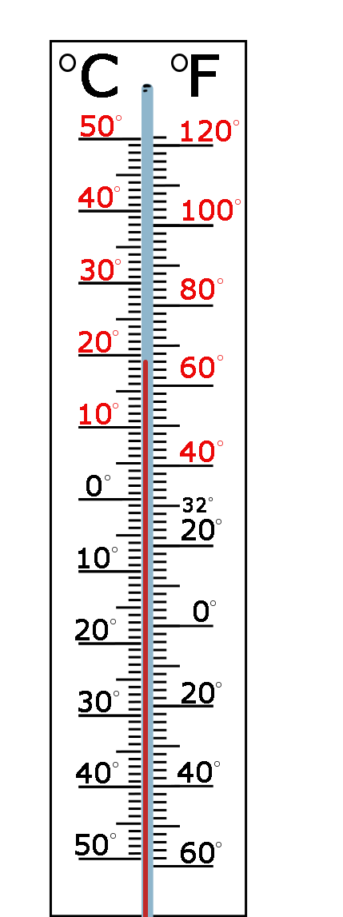
11.6.1 Warm-Up: Math Fail
A picture of a thermometer is shown.
Explain the error in the image.
Describe how to fix the image so that there is no “math fail.”
volume 2, pg. 190

Slide 7

Activity
volume 2, pg. 191

Slide 8

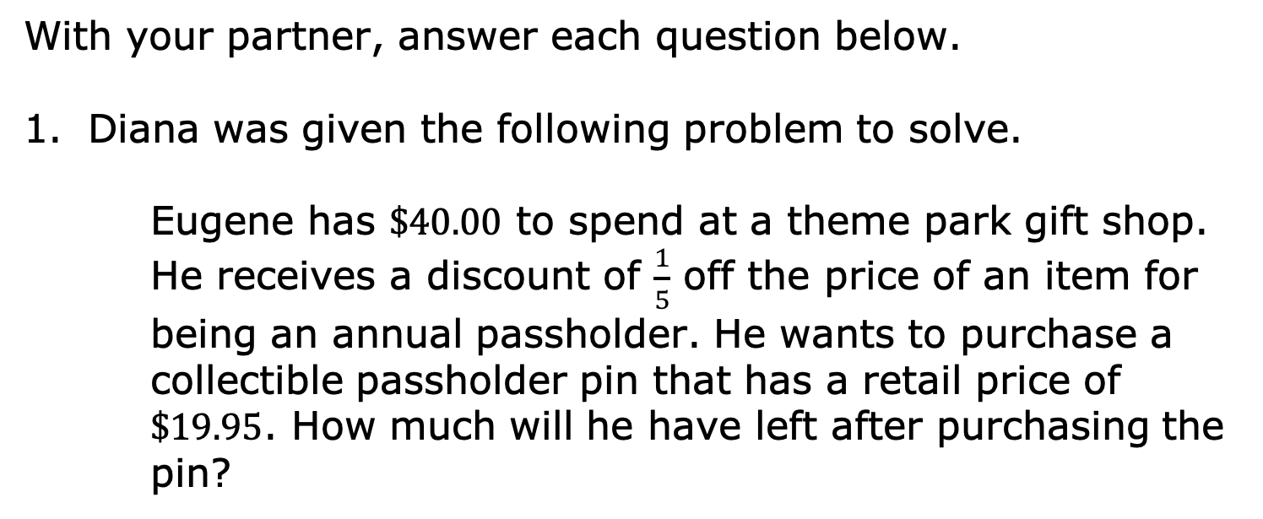
11.6.2 Activity: Error Analysis
With your partner, answer each question below.
Diana was given the following problem to solve.
Eugene has $\$40.00$ to spend at a theme park gift shop. He receives a discount of $\frac{1}{5}$ off the price of an item for being an annual passholder. He wants to purchase a collectible passholder pin that has a retail price of $\$19.95$. How much will he have left after purchasing the pin?
volume 2, pg. 191

Slide 9
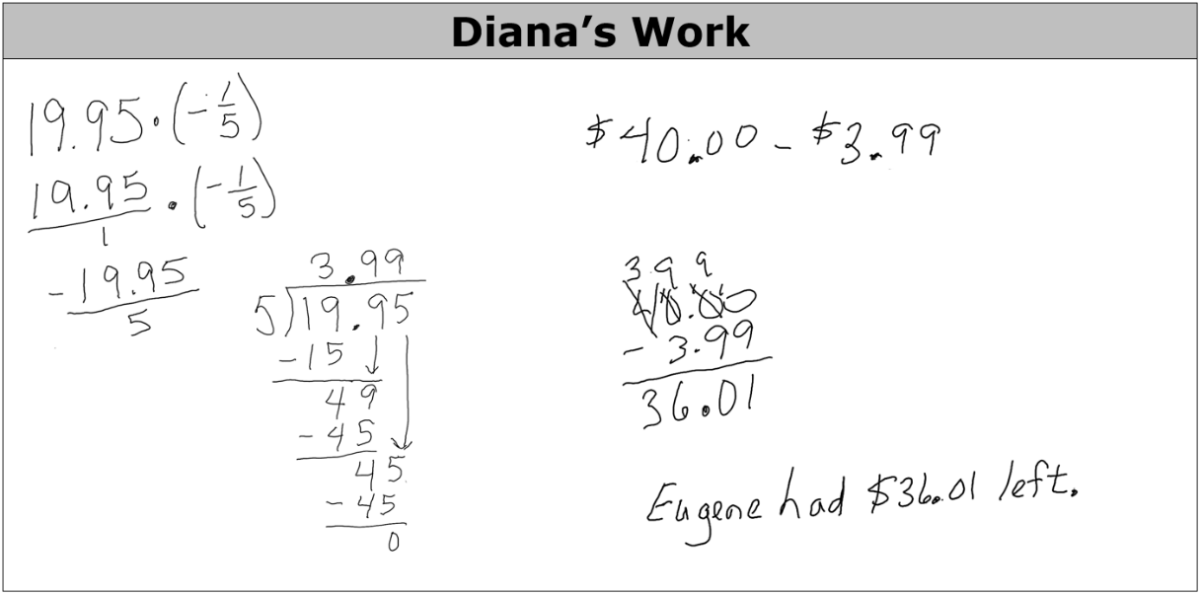
Diana solved the problem with the steps shown.
volume 2, pg. 191

Slide 10
Identify what Diana did correctly and incorrectly.
How much money will Eugene have left over after buying the pin? Show your work.
Correct | Incorrect
volume 2, pg. 191

Slide 11
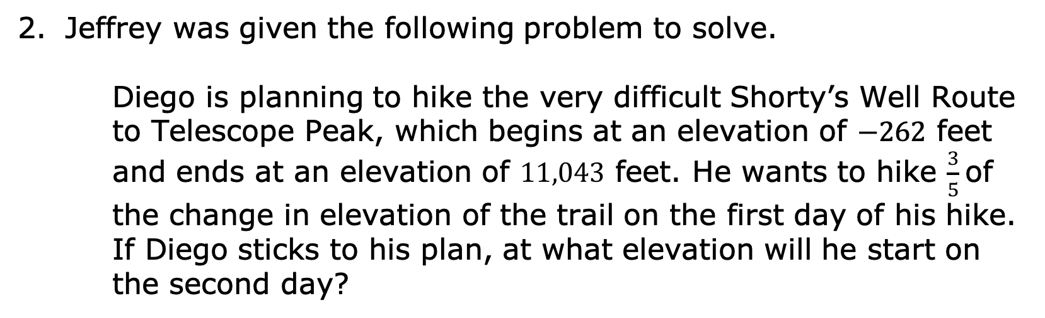
Jeffrey was given the following problem to solve.
Diego is planning to hike the very difficult Shorty’s Well Route to Telescope Peak, which begins at an elevation of $−262$ feet and ends at an elevation of $11,043$ feet. He wants to hike $\frac{3}{5}$of the change in elevation of the trail on the first day of his hike. If Diego sticks to his plan, at what elevation will he start on the second day?
volume 2, pg. 191

Slide 12
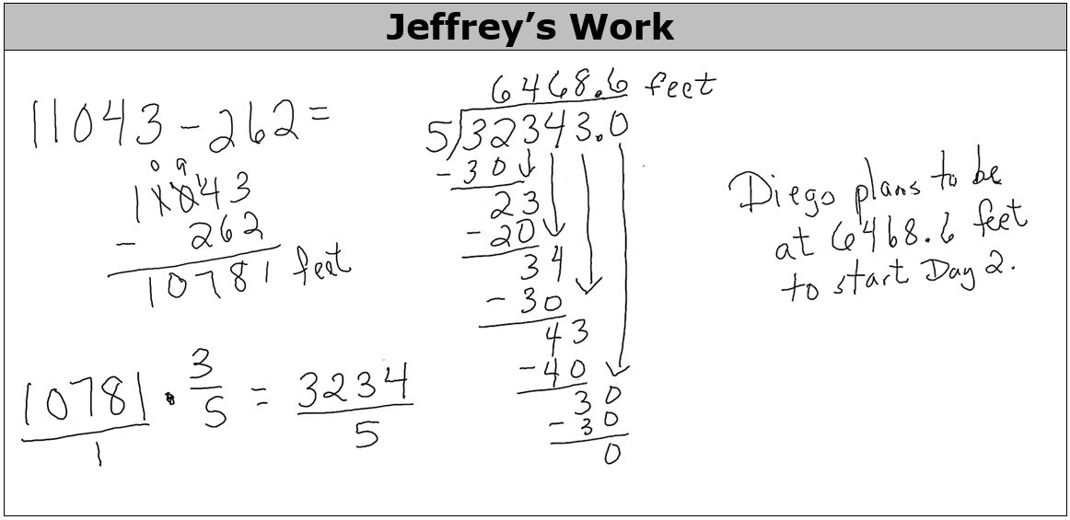
Jeffrey solved the problem with the steps shown.
volume 2, pg. 191

Slide 13
Identify what Jeffrey did correctly and incorrectly.
At what elevation will Diego start on the second day? Show your work.
Correct | Incorrect
volume 2, pg. 192

Slide 14
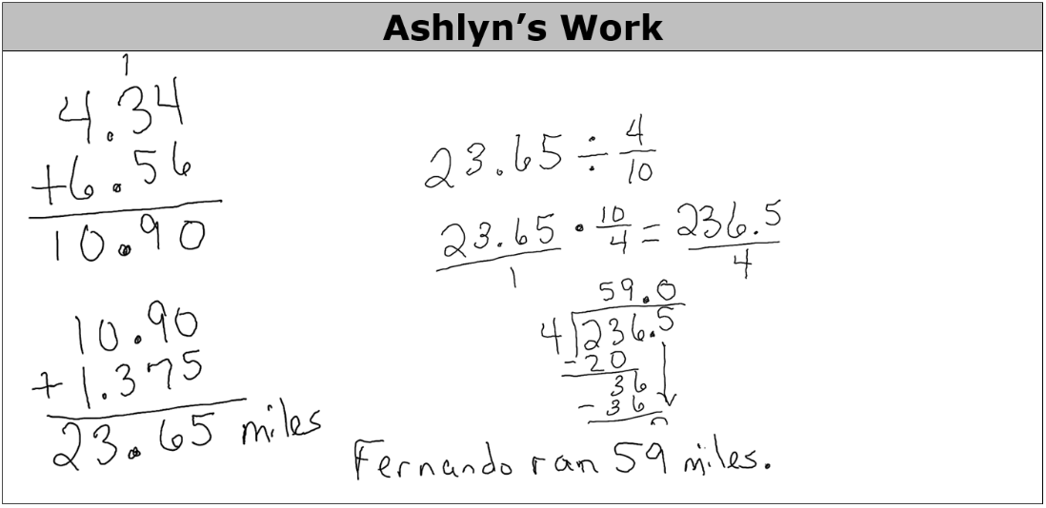
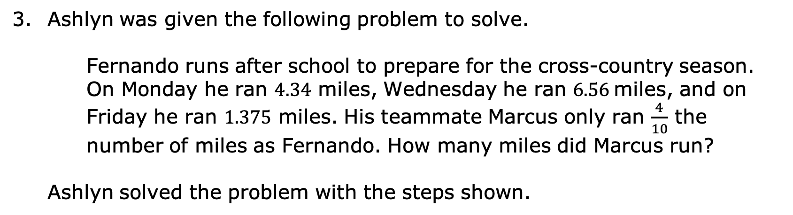
Ashlyn was given the following problem to solve.
Fernando runs after school to prepare for the cross-country season. On Monday he ran $4.34$ miles, Wednesday he ran $6.56$miles, and on Friday he ran $1.375$ miles. His teammate Marcus only ran $\frac{4}{10}$ the number of miles as Fernando. How many miles did Marcus run?
Ashlyn solved the problem with the steps shown.
volume 2, pg. 192

Slide 15
Identify what Ashlyn did correctly and incorrectly.
Correct | Incorrect
volume 2, pg. 192

Slide 16
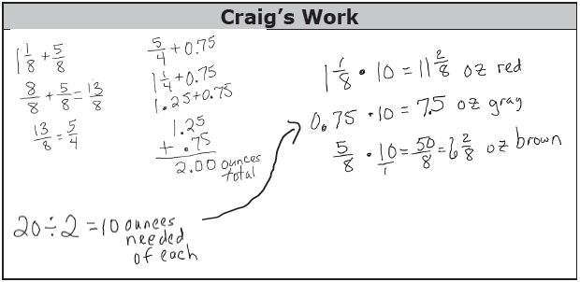
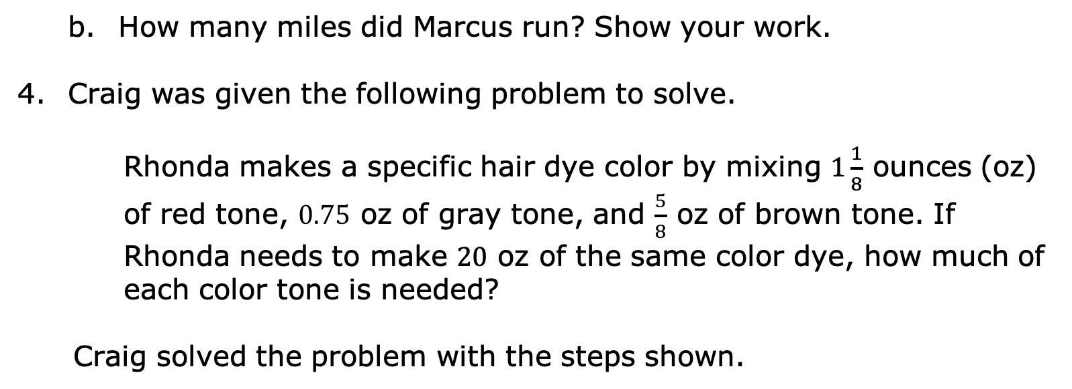
How many miles did Marcus run? Show your work.
Craig was given the following problem to solve.
Rhonda makes a specific hair dye color by mixing $1\frac{1}{8}$ ounces (oz) of red tone, $0.75$ oz of gray tone, and $\frac{5}{8}$ oz of brown tone. If Rhonda needs to make $20$ oz of the same color dye, how much of each color tone is needed?
Craig solved the problem with the steps shown.
volume 2, pg. 193

Slide 17

Identify what Craig did correctly and incorrectly.
How much of each color is needed to make $20$ oz of dye? Show your work.
Correct | Incorrect
volume 2, pg. 193

Slide 18

Collaboration
volume 2, pg. 194

Slide 19

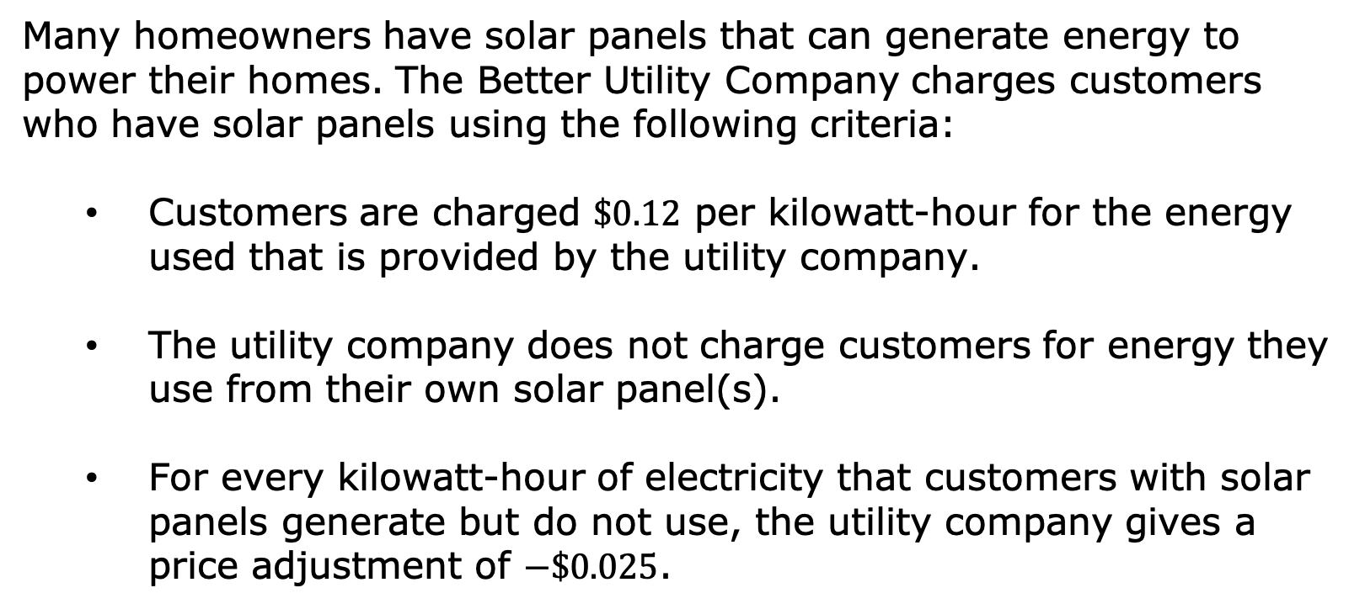
11.6.3 Collaboration: Finding Missing Values
Many homeowners have solar panels that can generate energy to power their homes. The Better Utility Company charges customers who have solar panels using the following criteria:
Customers are charged $\$0.12$ per kilowatt-hour for the energy used that is provided by the utility company.
The utility company does not charge customers for energy they use from their own solar panel(s).
For every kilowatt-hour of electricity that customers with solar panels generate but do not use, the utility company gives a price adjustment of $−\$0.025$.
volume 2, pg. 194

Slide 20
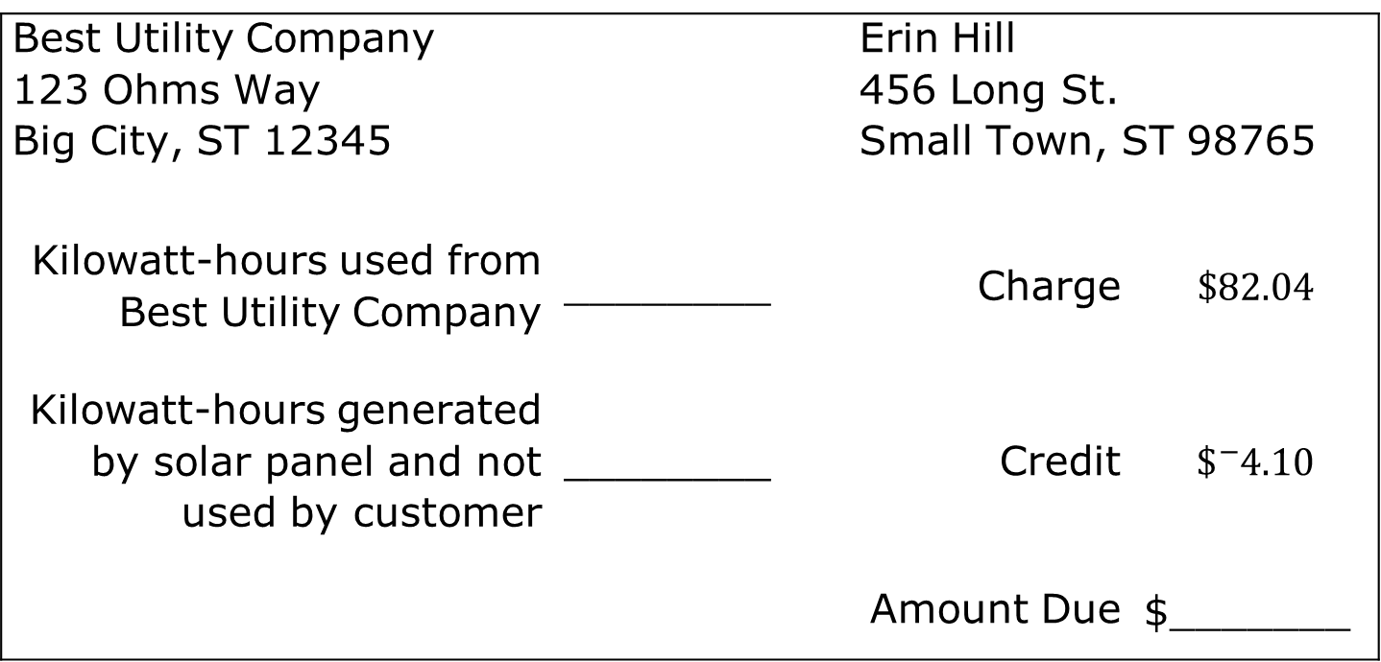
Erin Hill’s bill for the month of July is missing some information.
Best Utility Company 123 Ohms Way Big City, ST 12345 |  | Erin Hill 456 Long St. Small Town, ST 98765
Kilowatt-hours used from Best Utility Company | ________ | Charge | $$\$82.04$$
Kilowatt-hours generated by solar panel and not used by customer | ________ | Credit | $$\${}_{ }^{−}{4.10}$$
 |  | Amount Due | $_______
volume 2, pg. 194

Slide 21
Work with your partner to fill in the missing information on the bill. Round answers to nearest hundredth.
Find another classmate other than your partner and compare your missing values.
If the missing values for both are the same, have your classmate initial next to each value in your bill.
If the missing values are different, discuss your work to determine what error(s) were made. After correcting any mistakes, initial next to each value in each other’s bill.
volume 2, pg. 194

Slide 22

Wrap-Up
volume 2, pg. 195

Slide 23

11.6.4 Wrap-Up: Reflection
Complete the table by reflecting on the day’s lesson.
Today I deserve for …
volume 2, pg. 195

Slide 24
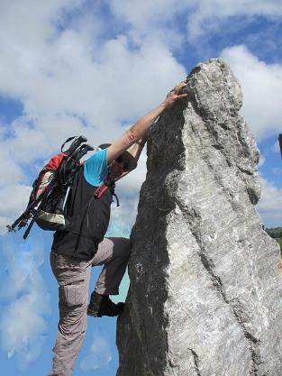
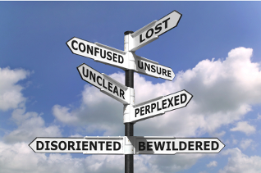
Today I by doing …
Today I was by …
volume 2, pg. 195

